Slide 1
Preprinting and Publishing in the Life and Biomedical Sciences
II: Understanding and Engaging with Preprints

Slide 2
Section 1
What are preprints? What is the impact of preprinting?

Slide 3
What is a preprint?
“A preprint is a full draft research paper that is shared publicly before it has been peer reviewed.”
Complete scientific manuscript posted to a preprint server, which is a publicly accessible platform to everyone around the world
Once document is uploaded, quality inspection occurs
Once accepted, preprints receive a DOI or persistent ID that can be cited
Preprints can be updated at any time by the authors
Notes:
Definition of preprint: https://www.aje.com/arc/benefits-of-preprints-for-researchers/
A preprint can be broadly defined as a scientific manuscript that is complete with all typical sections of a journal manuscript, including experimental details and data, that is posted by the authors to a publicly accessible platform.
Authors upload their document to a preprint server, which then goes through a quality-control inspection
Once accepted, preprints receive a DOI or a persistent identifier that can be cited
Preprints can be viewed by anyone with internet access without any associated cost.
Preprints can be updated by the authors at any time.

Slide 4










Preprints make work available almost immediately
Preprint server
Peer reviewed paper
<48 hrs screening process
Months to years
Public
Community feedback, ideas, discussion
Private
Journal 1
Journal 2
Journal 3
Submit
Manuscript
Peer Review
Revise
Revise
Emojis by Mozilla (CC BY 4.0)
Notes:
Slides taken from ASAPbio
Preprints address the problem of being able to share information quickly and openly, but still in a principled and standardized way

Slide 5
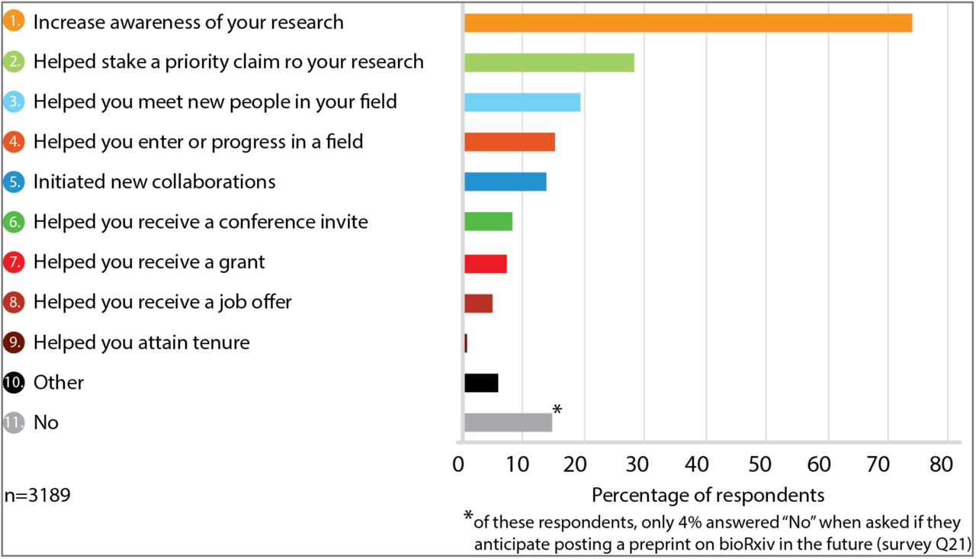
Benefits of preprints for scientists
https://www.biorxiv.org/content/10.1101/833400v1.full
Notes:
Slides taken from ASAPbio
Preprints present benefits for scientists:
Zero cost to post and to read
Can be cited via DOI or persistent ID -> gives authors credit
Permanent records (date-of-priority)
Track record productivity
Feedback via email and/or social media
Some journals have policies that promote preprints and allow for easy transfer of papers from server to journal and vice versa
Potential to develop needed collaborations earlier
Promote openness and transparency in science communication
Good resource is available here: https://asapbio.org/preprint-info/preprint-faq#qe-faqs-index

Slide 6


Preprints do not replace the peer review process,
rather they can enhance it
Disentangles scientific disclosure from peer-review validation
Peer Review comments on preprint can strengthen the manuscript prior to submission to a peer-reviewed journal
Community efforts, such as PREreview, provide platforms in which scientists can submit suggestions and comments on preprints
Crowdsourcing peer review

Slide 7
Section 2
What are the top concerns about preprints?

Slide 8
Preprints and Quality Control
Misinformation?
Risk of public health or society?
Deluge of Poor Papers?
Peer Review is undermined?
Notes:
Quality control is not present, as peer review does not take place. If we do not have measures to control the quality, preprints can lead to a deluge of poor papers; more importantly, risks to public health or society can be incurred, and the public trust in science can be eroded, if findings reported in a preprint are later found to be incorrect. Let’s go through these concerns one by on

Slide 9
‘Sharing preprints can cause premature media coverage and subsequent misinformation’
Misinformation concern is also shared with traditional peer-reviewed manuscripts
Can be addressed by inclusion of a research summary dedicated to lay persons (non-scientists)
If findings can directly be used in patient treatment or prevention, authors must make the study’s limitations clear
Preprints can be more easily retracted than “published” articles in journals
Notes:
The data and other information part of my manuscript will be shared publicly before peer review, potentially causing premature media coverage and subsequent misinformation
This concern is also shared with peer-reviewed manuscripts, as each scientific article has its own nuances that a non-scientist might interpret differently than a scientist within the field of expertise
This concern can be addressed by including a summary of the research findings dedicated to just lay readers
If findings of the research can be potentially used in the context of human health or treatment of patients, the authors need to be as clear as possible about their findings and state the limitations of the study

Slide 10
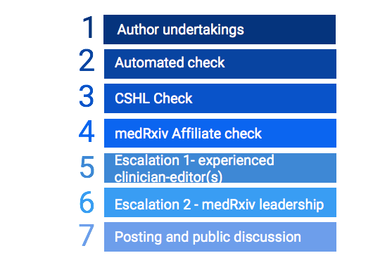
‘Without peer review, there is a risk to public health’
Risk mitigation framework - medRxiv
Is it nonsense?
Is it non-science?
Is it a paper?
Is it research?
Is it plagiarized?
Is it a health threat?
Is there a benefit to sharing now vs. after peer review?
Theo Bloom, presentation at FORCE2019 http://bit.ly/preprints-FORCE2019
Notes:
https://docs.google.com/presentation/d/1oI2DwI1tW76IHSW5JIOeoH0NhGQ1Iogr46ZHsEn4684/edit#slide=id.g88e5795e40_0_127
From medRxiv FAQ- Article screening typically completes within 4–5 days, however, it may take longer over a weekend or holiday, or if there are concerns about whether the paper is within scope.
Many preprint platforms have screening procedures for submissions prior to posting.
PREreview and Review Commons feedback

Slide 11
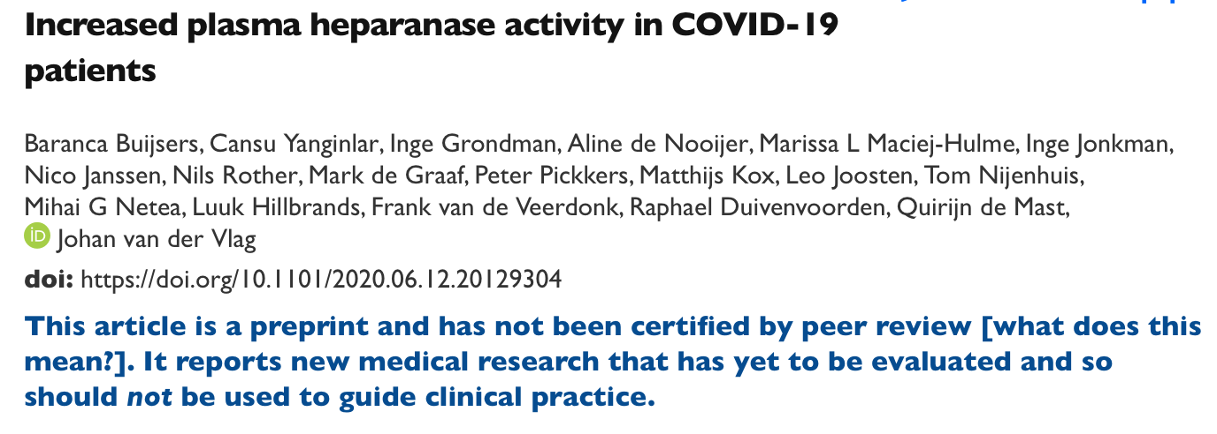
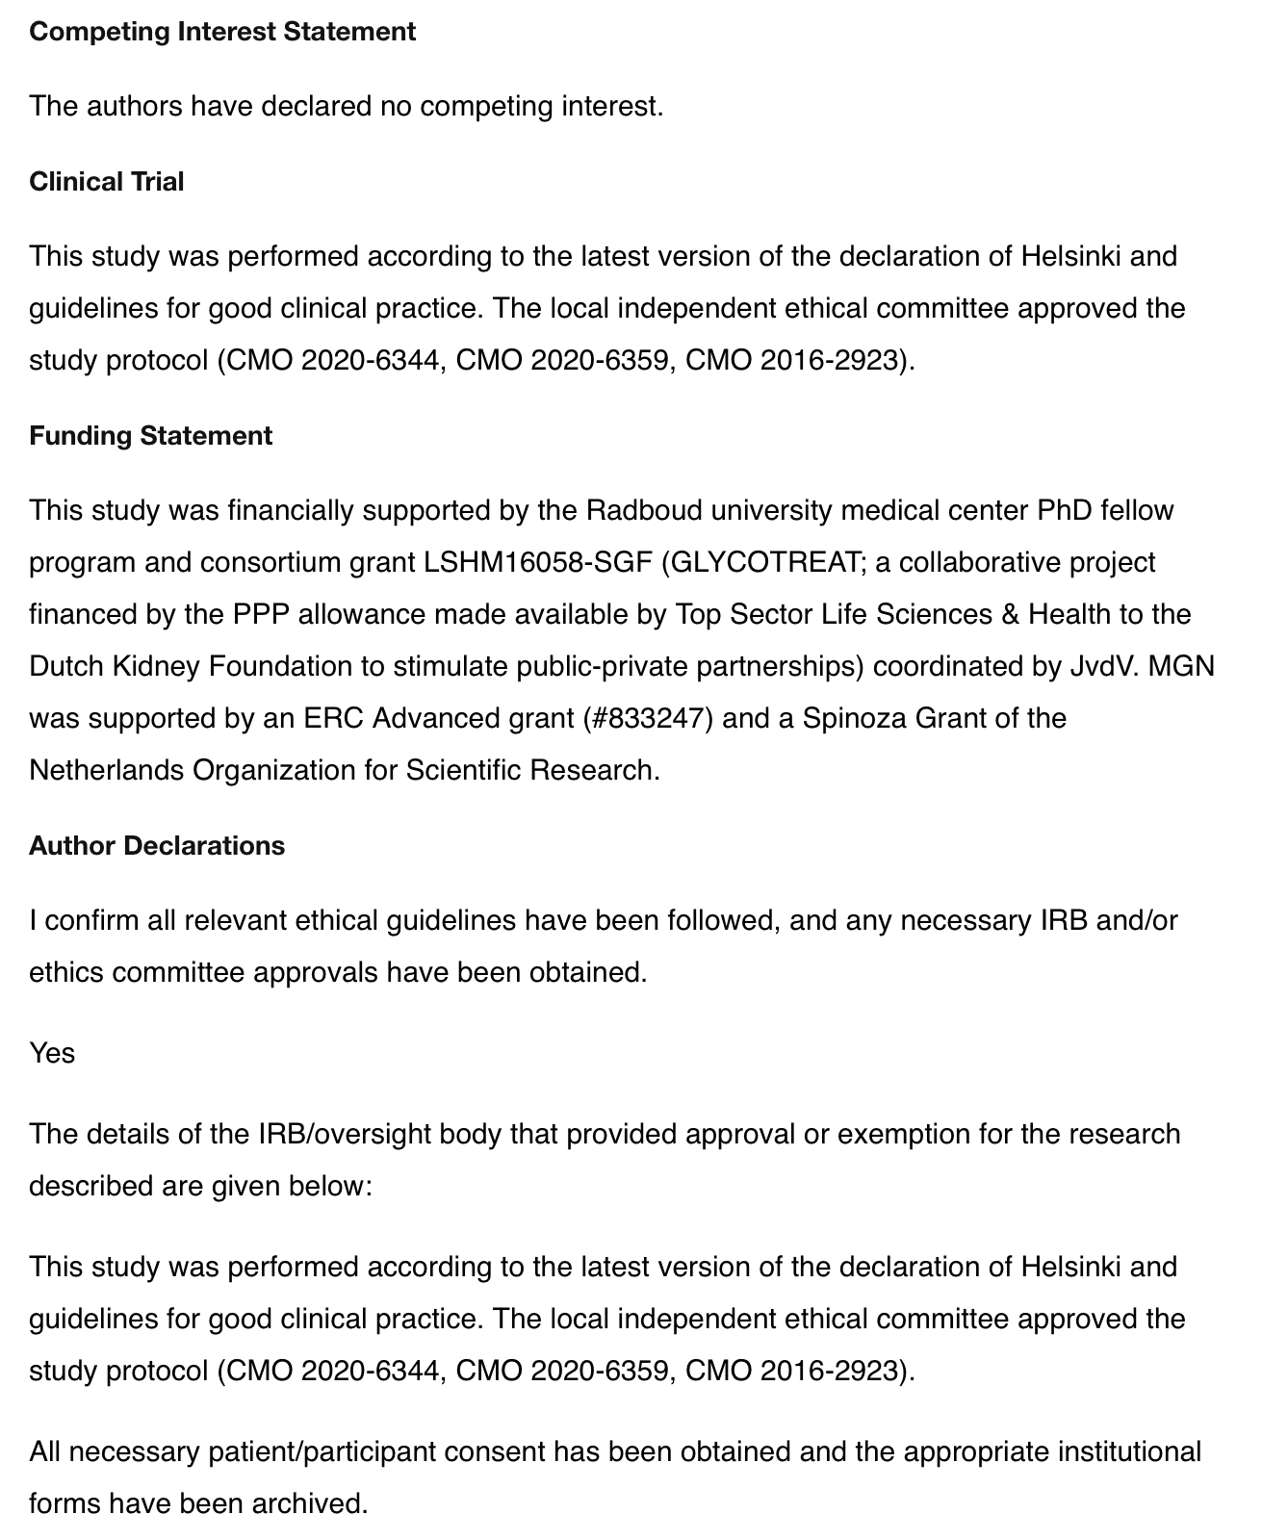
‘Without peer review, there is a risk to public health’
medRxiv requires declarations in line with those required for reporting of clinical work in peer-reviewed literature:
Competing interests
Funding statement
Ethical approval/consent
Clinical trial registration
As well as data statements (beyond what some journals operate)
Notes:
https://docs.google.com/presentation/d/1oI2DwI1tW76IHSW5JIOeoH0NhGQ1Iogr46ZHsEn4684/edit#slide=id.g88e5795e40_0_127
From medRxiv FAQ- Article screening typically completes within 4–5 days, however, it may take longer over a weekend or holiday, or if there are concerns about whether the paper is within scope.
medRxiv, a highly used platform to submit preprints involving medical research, requires declarations in line with those required for reporting clinical work in peer-reviewed journals, such as: competing interests, funding statement, ethical approval/consent, clinical trial registration. Additionally, they require data statements, which is beyond what some journals require.

Slide 12
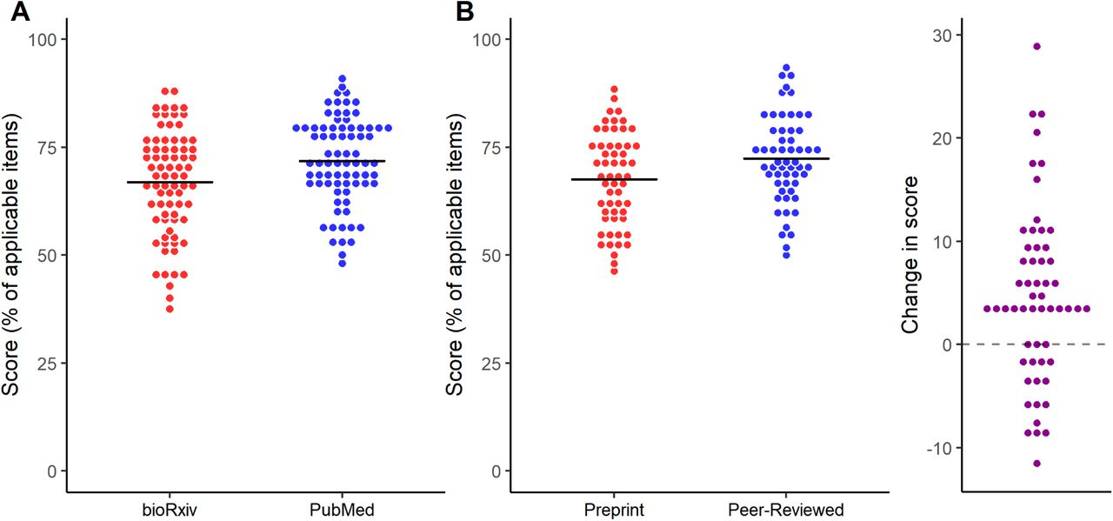
‘Preprints will lead to a deluge of poor papers’
Peer-reviewed articles have higher quality of reporting than preprints, but the difference is small
5.0 % in independent sample
4.7 % in paired sample comparison
Comparison of random sample (76) of bioRxiv preprints to peer-reviewed articles from PubMed, and a paired comparison of a sample (43) of bioRxiv preprints to their own peer-reviewed article versions
Comparing quality of reporting between preprints and peer-reviewed articles in the biomedical literature. Carneiro et al. bioRxiv 581892; doi: https://doi.org/10.1101/581892
Notes:
https://docs.google.com/presentation/d/1oI2DwI1tW76IHSW5JIOeoH0NhGQ1Iogr46ZHsEn4684/edit#slide=id.g88e5795e40_0_127
‘Changes in reporting from preprints to peer-reviewed versions did not correlate with the impact factor of the publication venue or with the time lag from bioRxiv to journal publication’
‘it is worth noting that the greatest difference observed from preprints to their peer- reviewed versions was the prevalence of conflict of interest statements, an item that is commonly required at journal submission. Thus, some of the observed changes could be attributable to other features of the editorial process, rather than to the actual feedback provided by reviewers.’

Slide 13
‘Preprints can undermine the value of peer review’
That is certainly not the goal of preprints; in fact, preprints are meant to encourage more peer review!
PREreview allows scientists to submit review of preprints
These reviews can be potentially integrated in the publishing workflow
Notes:
Preprints can undermine the value of peer-reviewed journals, which might also not accept manuscripts if they are already posted to a preprint server.
Preprints are not meant to replace peer review, in fact they are meant to encourage more of it! Scientists can peer review preprints through community advances such as PREreview and preprint servers themselves, some of which allow comments on the preprint record. These reviews can be integrated within the journal submission workflow.
Each journal does have its own policy on preprints, can check Sherpa or Romeo; most journals do allow preprints.
2/3s of preprints are published within two years
Some journals even use preprints as a marketplace for publications; editors “shop around” and then can contact you about your paper

Slide 14
Preprints and Scientific Careers
Scooping?
Journal won’t publish my work?
What’s in it for me?

Slide 15
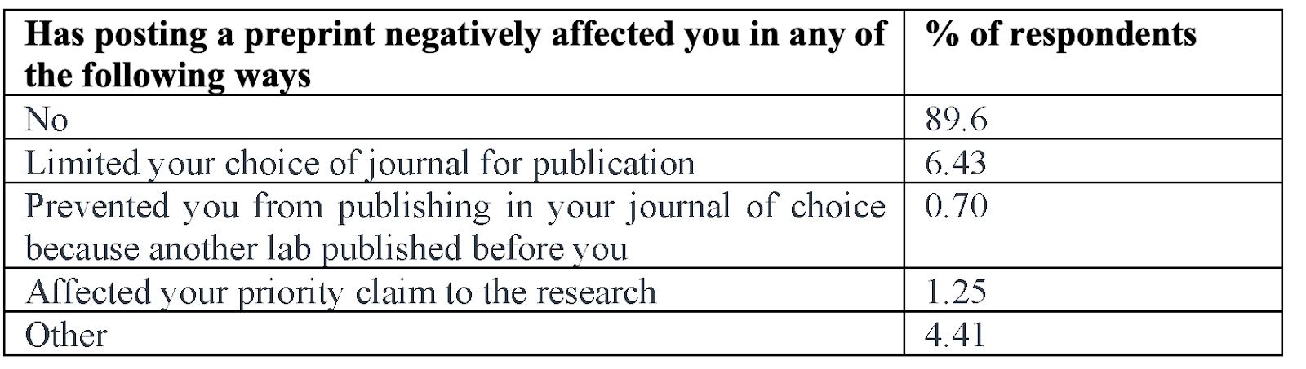
‘My work will be scooped’
bioRxiv survey N=3127
‘bioRxiv: the preprint server for biology’ https://doi.org/10.1101/833400
There is no evidence that preprints increase risk for scooping
Paul Ginsparg, founder of arXiv on scooping: “It can’t happen, since arXiv postings are accepted as date-stamped priority claims.”
Resources on scooping available on ASAPbio website: https://asapbio.org/preprint-info/preprint-faq A number of journals operate scooping protection policies: EMBO, eLife, PLOS journals
Notes:
https://docs.google.com/presentation/d/1oI2DwI1tW76IHSW5JIOeoH0NhGQ1Iogr46ZHsEn4684/edit#slide=id.g88e5795e40_0_127
Won’t I be scooped?
No evidence for association between preprinting and scooping
Preprints are date-stamped, giving preprints a date of priority.
Scooping occurs less than you think - most work is original and unique enough that being scooped is not a major concern
Although most reagents and assays are widely available, most work is not easy to replicate within a few weeks or even months by an unscrupulous scientist.
Can help in accidental scooping situations, in which two different groups are unknowingly working on the same project at the same time, and one group is able to publish a preprint a bit faster than the second group.
In this case, the second group must cite the first group
If the second group’s preprint appears just a few weeks after the first group’s preprint, it is clear that the second group couldn’t have replicated the results so fast and thus have independently done similar work
Source: https://asapbio.org/preprint-info/preprint-faq#scooping

Slide 16
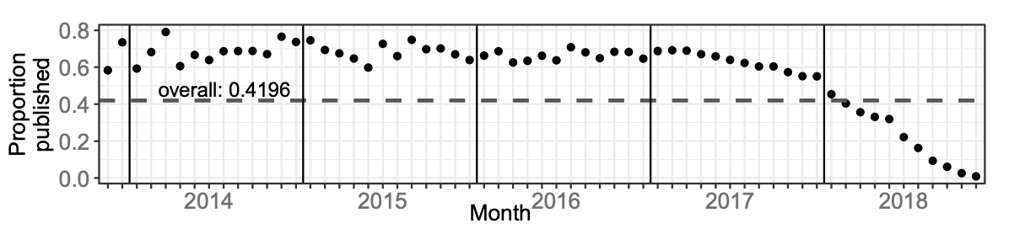
‘The journal will not publish my work’
Abdill & Blekhman; eLife 2019;8:e45133
⅔ of preprints are published within two years
The study by Addill & Blekhman focused on preprints in bioRxiv, the same statistic has been reported for preprints in arXiv (Larivière et al. Journal of the American Society for Information Science and Technology, 65(6): 1157–1169)
Notes:
https://docs.google.com/presentation/d/1oI2DwI1tW76IHSW5JIOeoH0NhGQ1Iogr46ZHsEn4684/edit#slide=id.g88e5795e40_0_127

Slide 17



















‘The journal will not publish my work’
SHERPA/RoMEO lists over 1,200 publishers with policies that accept preprints
TRANSPOSE database (https://transpose-publishing.github.io/#/) provides information on preprint policies at journals
Some journals give the authors the option to post the paper at a partner preprint platform in parallel to consideration at the journal
Some journals have dedicated editors who check preprints to invite submission to the journal (see https://asapbio.org/journal-policies for more info on innovative journal practices)
Notes:
https://docs.google.com/presentation/d/1oI2DwI1tW76IHSW5JIOeoH0NhGQ1Iogr46ZHsEn4684/edit#slide=id.g88e5795e40_0_127

Slide 18









‘What’s in it for me?’
A number of funders encourage preprints as evidence of productivity in grant applications & reports
List and links to policies at asapbio.org/funder-policies
Notes:
https://docs.google.com/presentation/d/1oI2DwI1tW76IHSW5JIOeoH0NhGQ1Iogr46ZHsEn4684/edit#slide=id.g88e5795e40_0_127
Funder policies are changing, and are starting to encourage the use of preprints as evidence of productivity - so it’s no longer limited to peer-reviewed articles
Preprints are allowed as part of REF

Slide 19
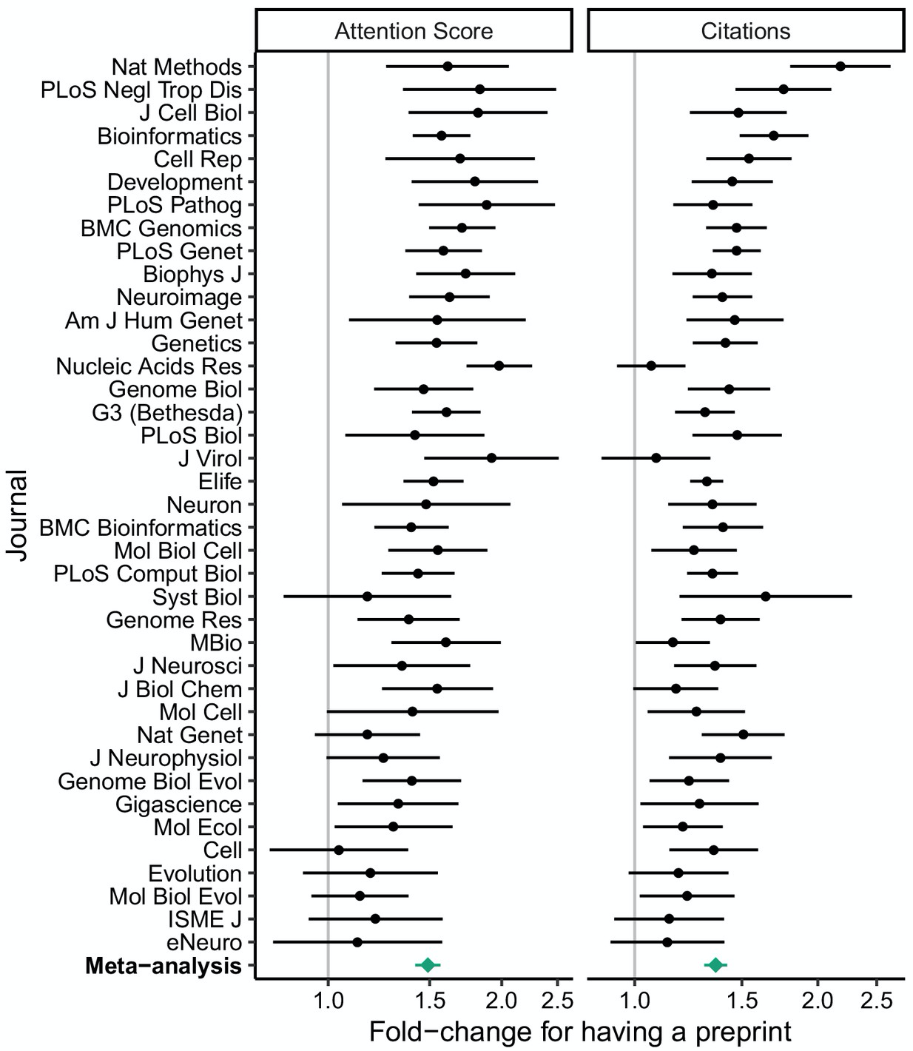
‘What’s in it for me?’
Having a preprint on bioRxiv is associated with a higher Altmetric Attention Score and more citations of the peer-reviewed article
Fu and Hughey. eLife 2019;8:e52646. DOI: https://doi.org/10.7554/eLife.52646
Notes:
https://docs.google.com/presentation/d/1oI2DwI1tW76IHSW5JIOeoH0NhGQ1Iogr46ZHsEn4684/edit#slide=id.g88e5795e40_0_127
74,239 articles, 5,405 of which had a preprint, published in 39 journals between January 1, 2015 and December 31, 2018

Slide 20
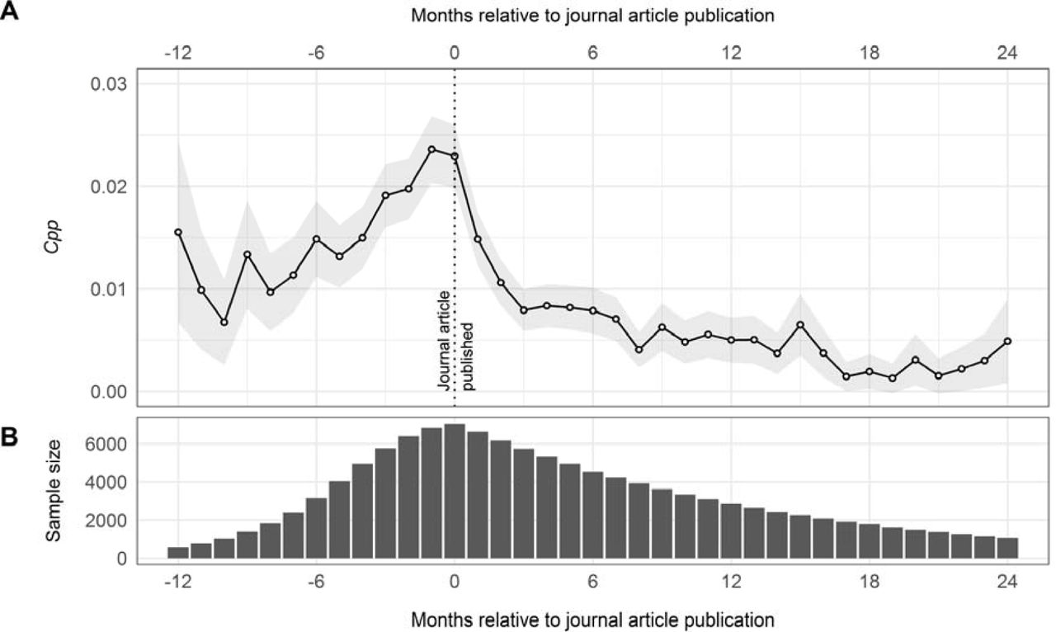
‘What’s in it for me?’
Papers posted to bioRxiv receive citations prior to journal publication
Preprints can extend the reach of the work
The effect of bioRxiv preprints on citations and altmetrics. Nicholas Fraser, Fakhri Momeni, Philipp Mayr, Isabella Peters. bioRxiv 673665; doi: https://doi.org/10.1101/673665
Notes:
https://docs.google.com/presentation/d/1oI2DwI1tW76IHSW5JIOeoH0NhGQ1Iogr46ZHsEn4684/edit#slide=id.g88e5795e40_0_127
‘our results provide support for depositing preprints as a means to extend the reach and impact of work in the scientific community’
Cpp - monthly citations per paper

Slide 21
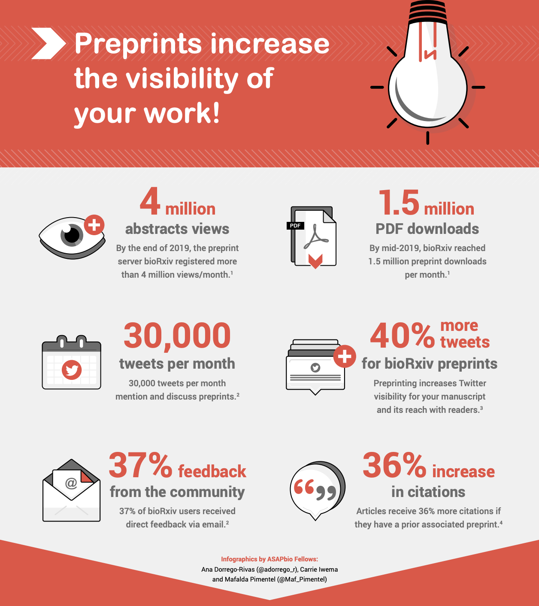
What’s in it for me?
Notes:
Infographic here: https://asapbio.org/wp-content/uploads/2020/12/ASAPbio-preprints-visibility-english.pdf

Slide 22
Section 3
What are the components of a preprint?

Slide 23
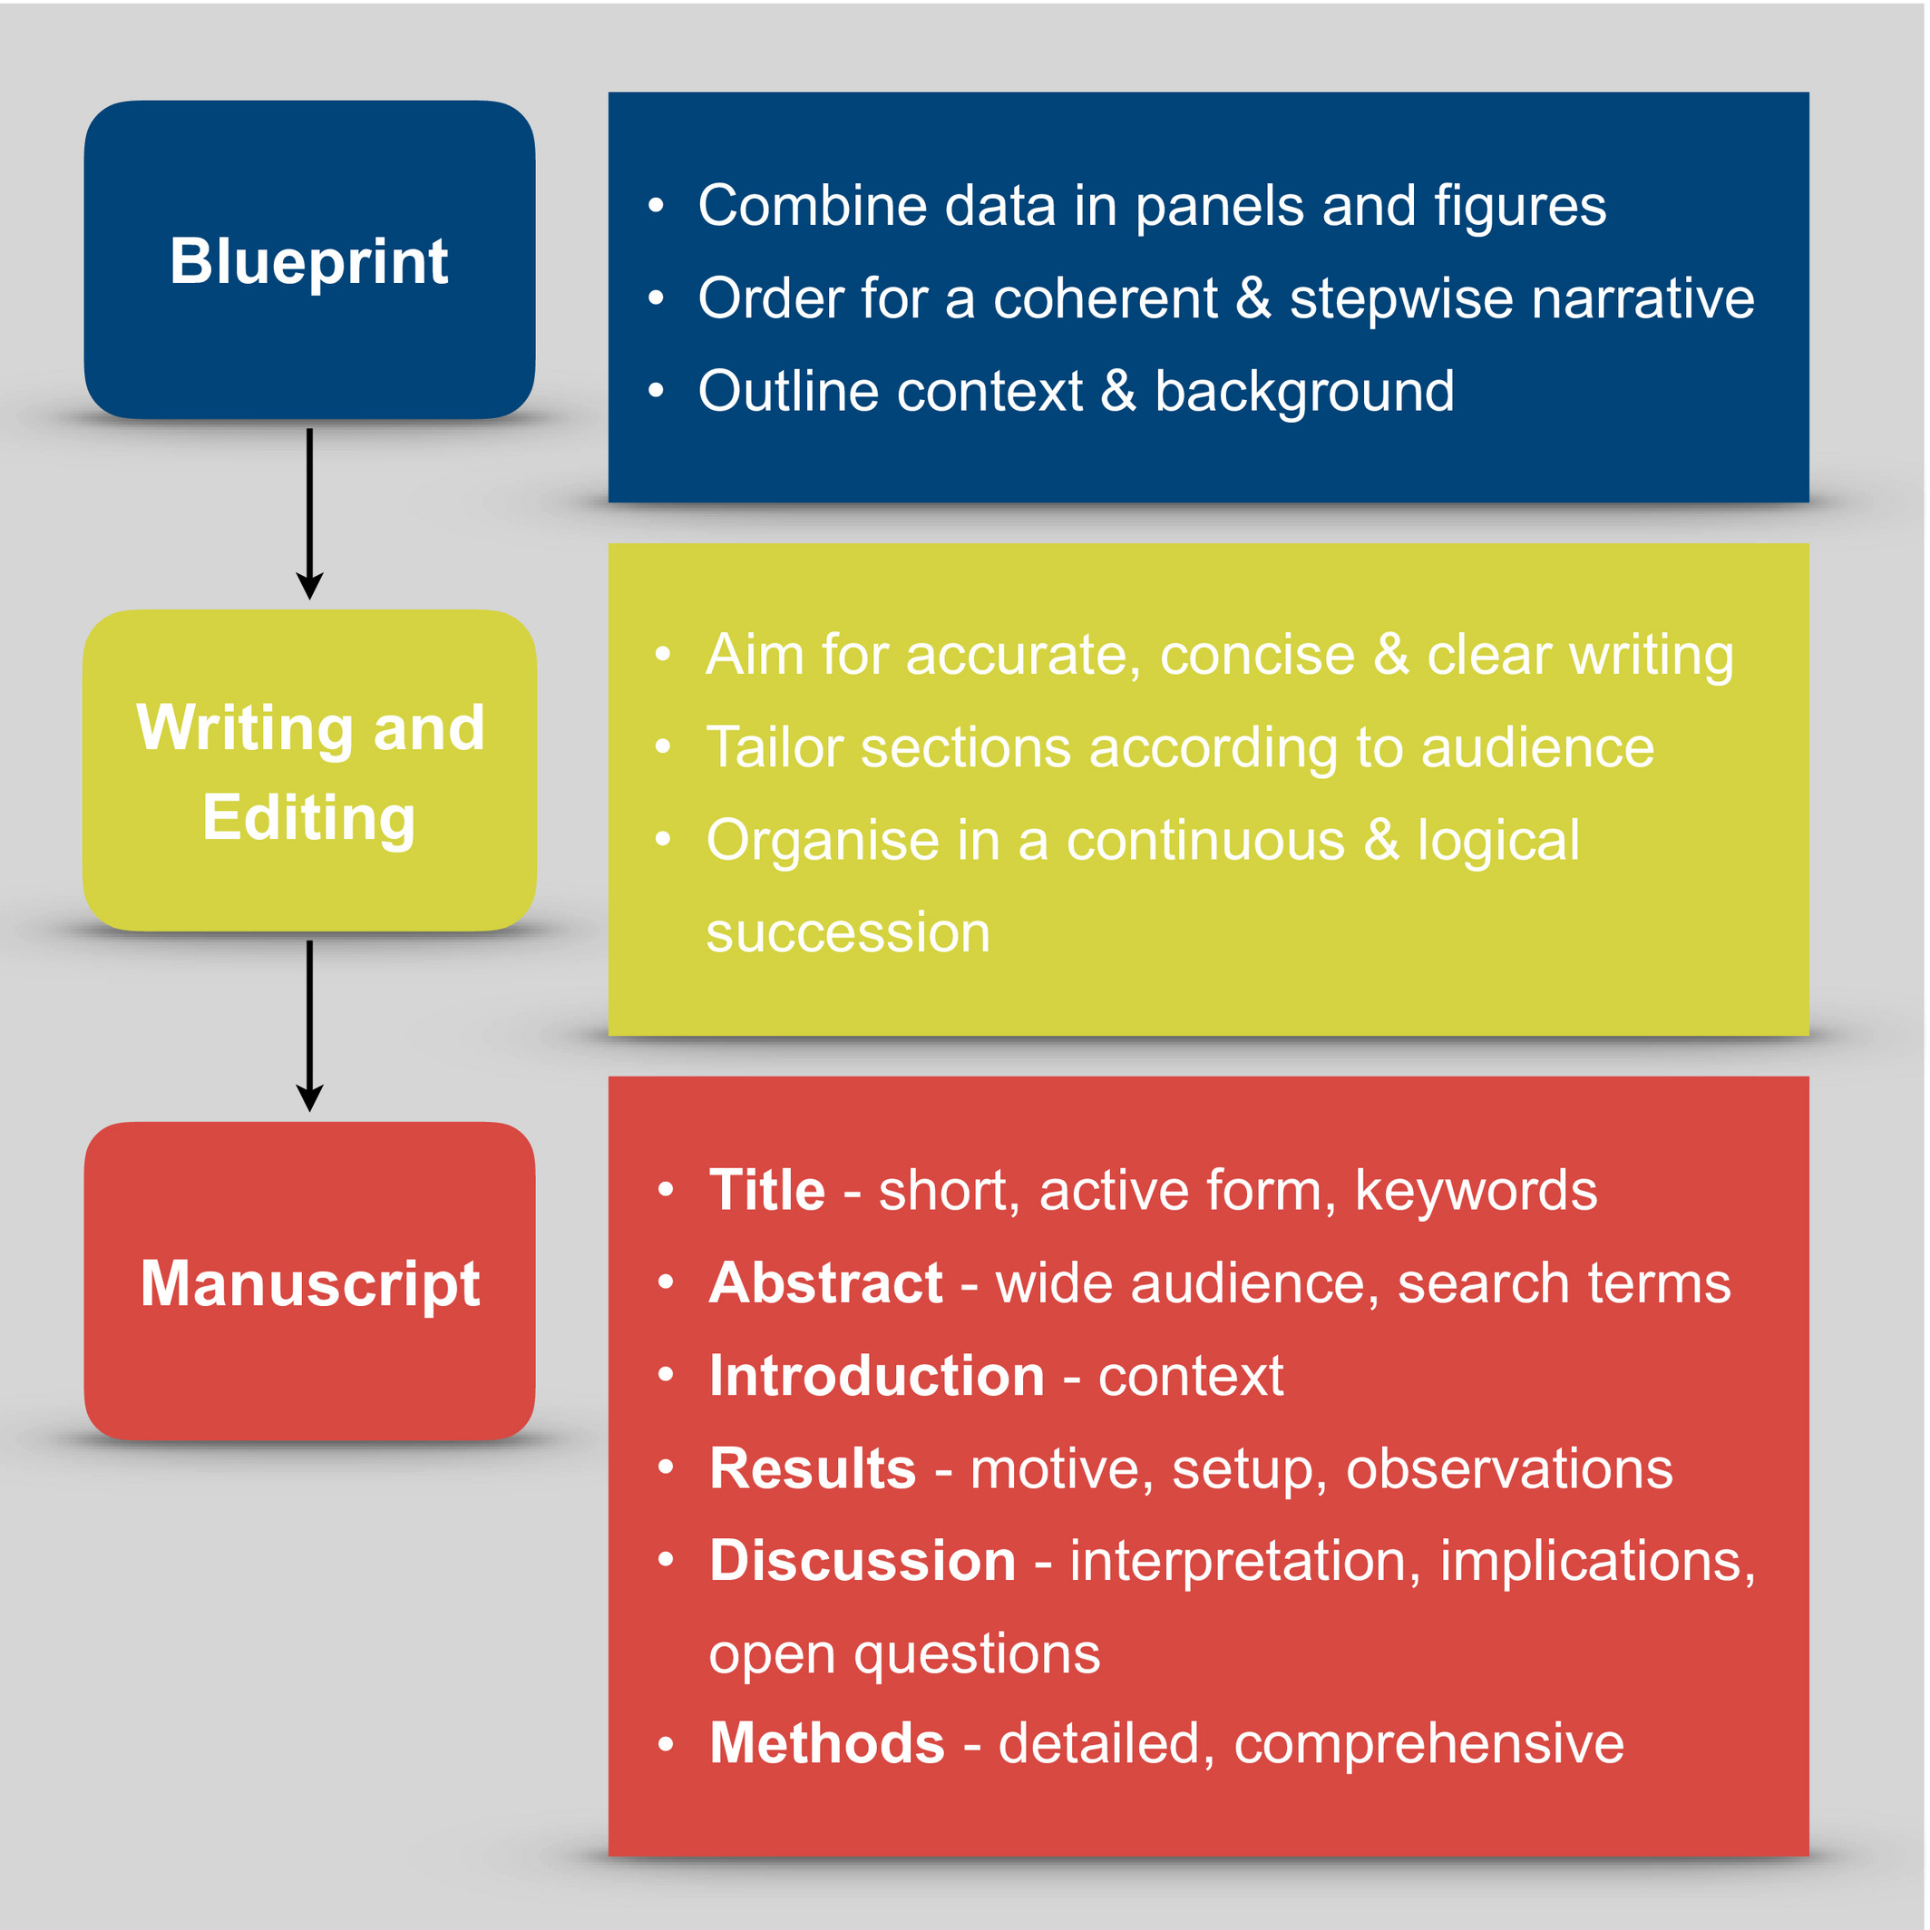
Manuscript:
Complete scientific work
Structure and content:
Should contain all the sections relevant to a scientific article
Manuscript length and format:
A preprint has more freedom compared to a journal submission
On quality:
Review the manuscript to avoid scientific and grammatical errors
The FEBS Journal, Volume: 283, Issue: 21, Pages: 3882-3885, First published: 07 November 2016, DOI: (10.1111/febs.13918)

Slide 24
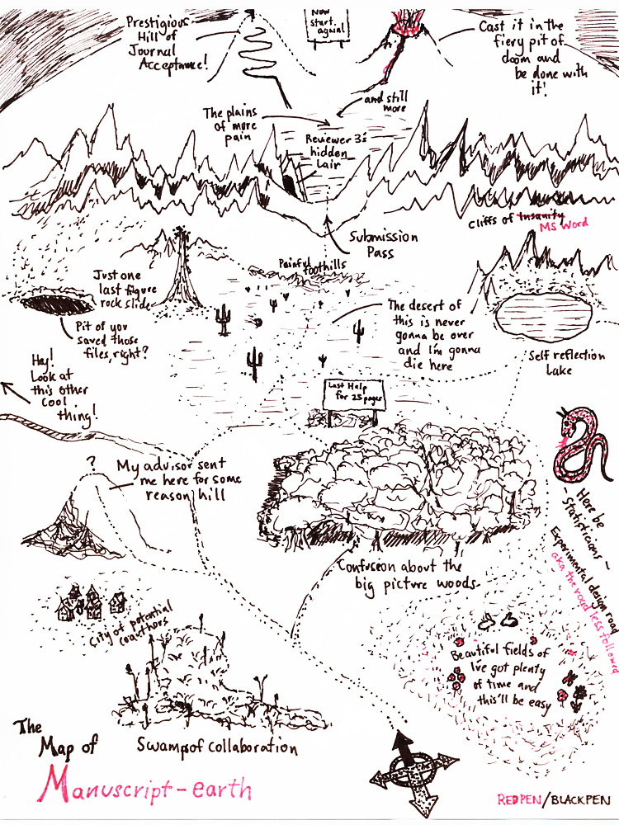
Manuscript:
The process of research and writing a manuscript is lengthy and with a lot of hurdles to overcome.
https://www.redbubble.com/people/redpenblackpen/shop?ref=artist_title_name
Notes:
Before Journal submission
At journal submission AND before peer-review
After peer-review but before acceptance:
Journals have different policies: Some disapprove of this while others do not mind it.
After Journal acceptance - This is unethical by most publishers
Posting on multiple servers:
This may affect the curation and metrics used in evaluating preprint by preprint curators
Multiple versions/revisions:
New pre-print versions may be displayed preferentially but all versions are considered permanent citable scientific communications and can only be withdrawn due to “significant ethical or legal concerns”

Slide 25
Manuscript: when to post
3.
Before Journal submission
At journal submission AND/OR before peer-review
After peer-review but before acceptance
Subject to journal policies which vary.
2.
1.
https://www.redbubble.com/people/redpenblackpen/shop?ref=artist_title_name
Notes:
Before Journal submission
At journal submission AND before peer-review
After peer-review but before acceptance:
Journals have different policies: Some disapprove of this while others do not mind it.
After Journal acceptance - This is unethical by most publishers
Posting on multiple servers:
This may affect the curation and metrics used in evaluating preprint by preprint curators
Multiple versions/revisions:
New pre-print versions may be displayed preferentially but all versions are considered permanent citable scientific communications and can only be withdrawn due to “significant ethical or legal concerns”

Slide 26
When can preprints be posted?
“Nature Portfolio journals encourage posting of preprints of primary research manuscripts on preprint servers... ...preprints may be posted at any time during the peer review process”
Nature Research
“... we do not support posting to preprint servers revisions that respond to editorial input and peer review or final accepted manuscripts. Once your paper is published, we encourage you to update the preprint record with a link to the final published article. Please see our prepublication publicity policies ...”
Cell Press

Slide 27
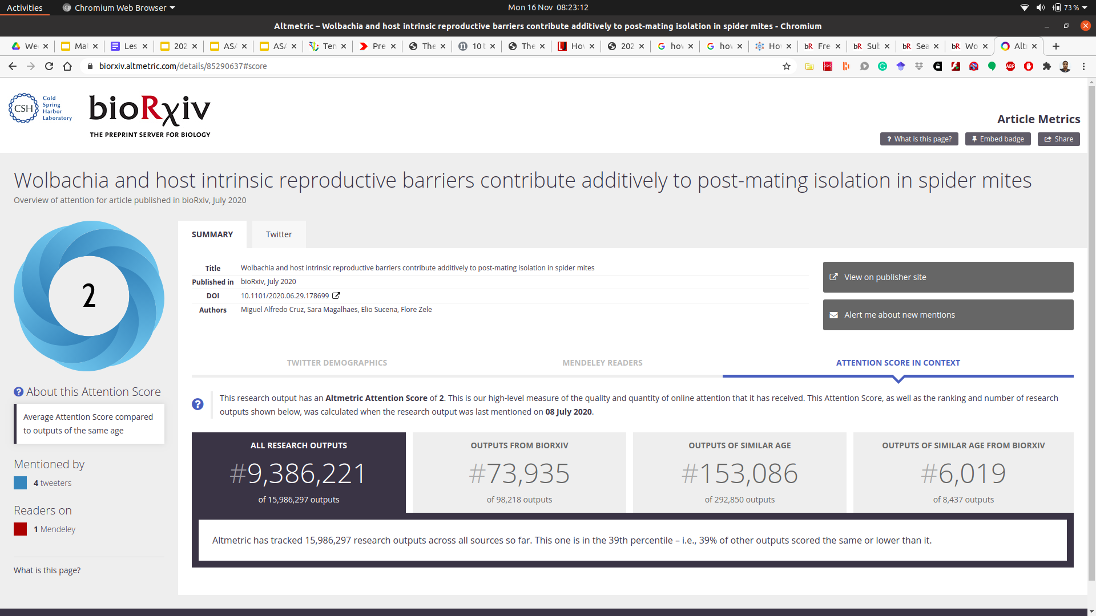
Posting on Multiple servers
“We recommend that a preprint is posted on only one server. bioRxiv provides metrics for article views, PDF downloads, and attention scores.” bioRxiv
Notes:
Quality Control Checks:
Primary QC on submission - ensures that it meets the standards of a scientific manuscript
Secondary QC - assess scientific soundness and public safety concerns
Licences to use VS how open: (https://asapbio.org/licensing-faq/licensing-diagram-v2019-08-04)
No License - All rights reserved
CC0 Waiver - Waives all copyrights and related rights
CC BY - Allows reuse and modification with attribution
CC BY-[SA/NC/ND] - CC BY with conditions: ShareAlike, NonCommercial and No Derivatives
Copyrights and patent:
The author/authors can chose a licence that best fits their need. A CC licence is irrivocable.

Slide 28
Multiple versions/revisions:
New pre-print versions may be displayed preferentially
Versions are considered permanent citable scientific communications - can only be withdrawn due to “significant ethical or legal concerns”
“An article posted on bioRxiv can be revised at any time, until it is accepted for publication….To correct errors in your article or Supplementary file, please submit a revised version of your article.”
-bioRxiv

Slide 29
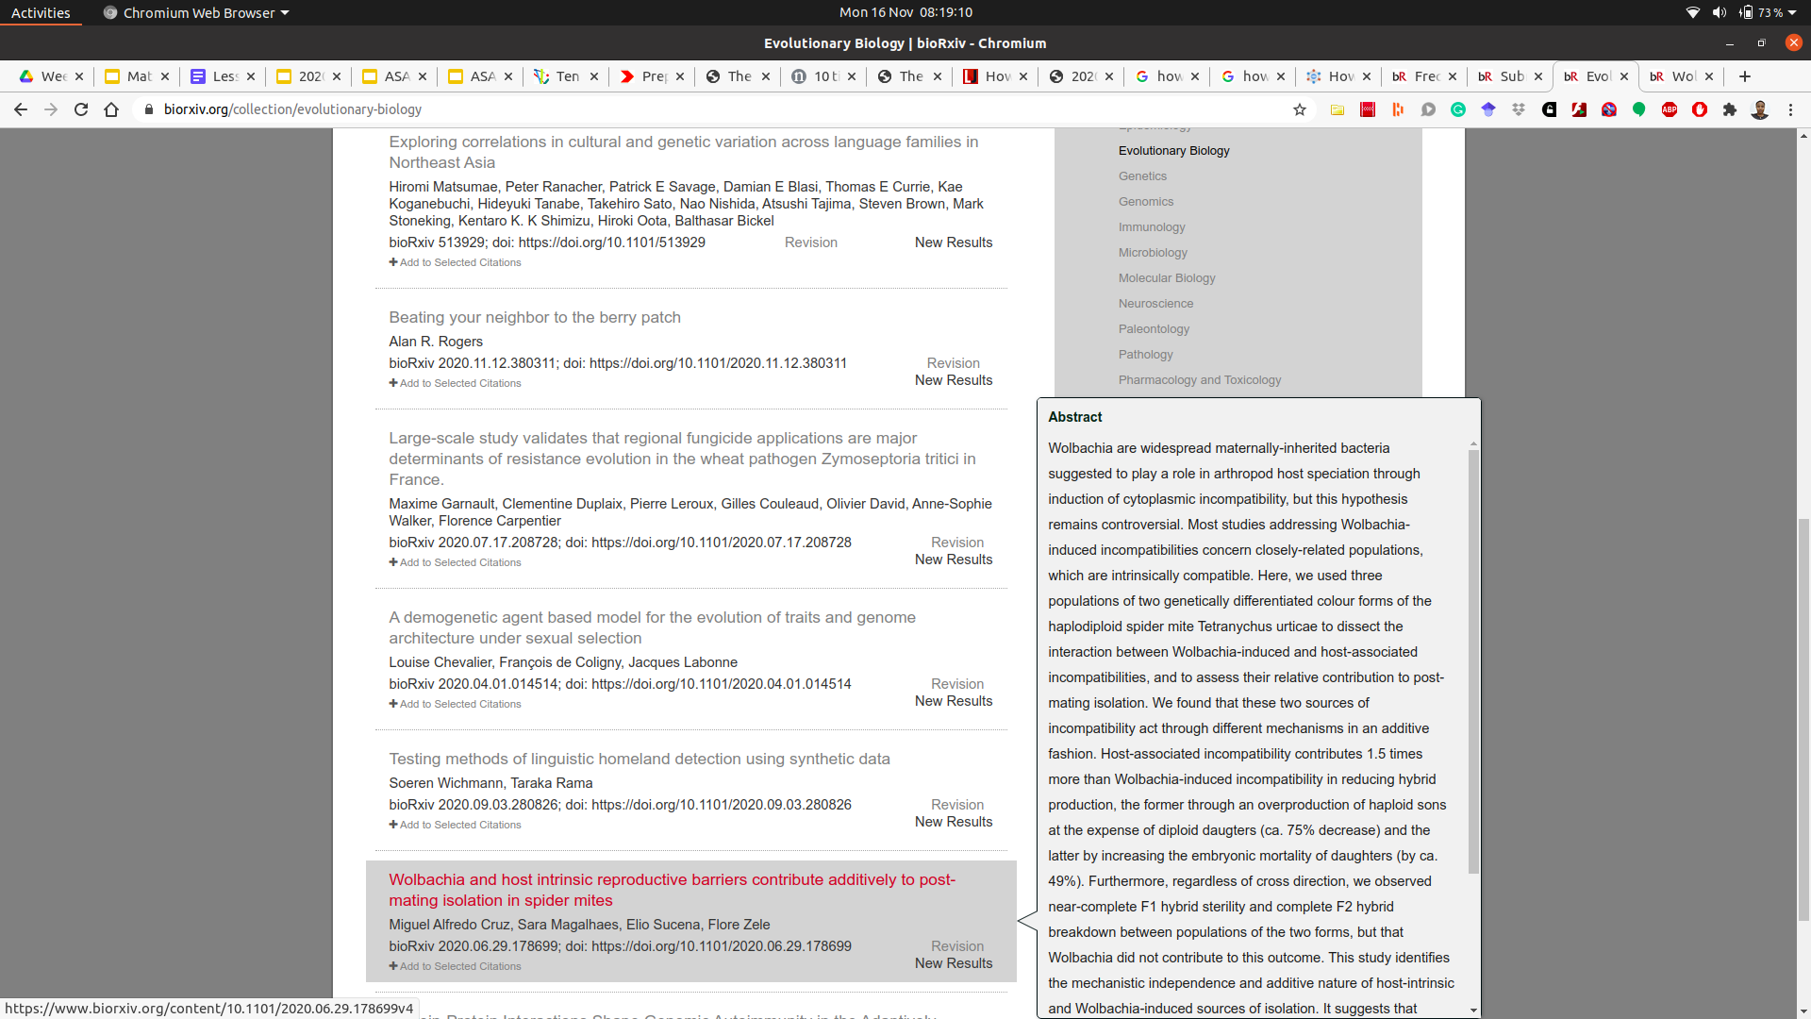
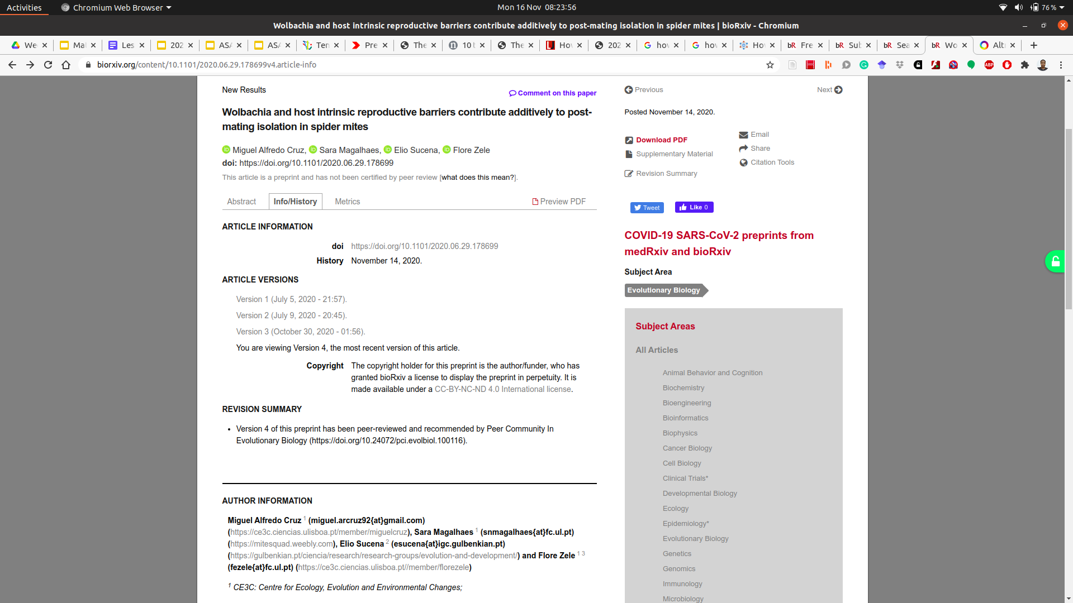
Multiple versions/revisions:

Slide 30
Open Science & Preprints

Slide 31
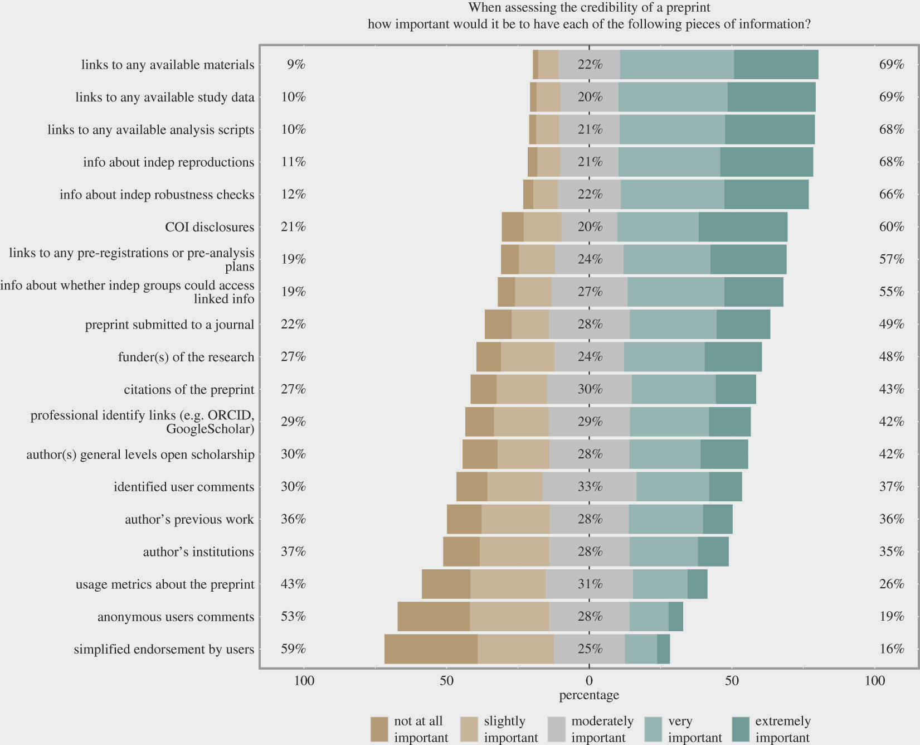
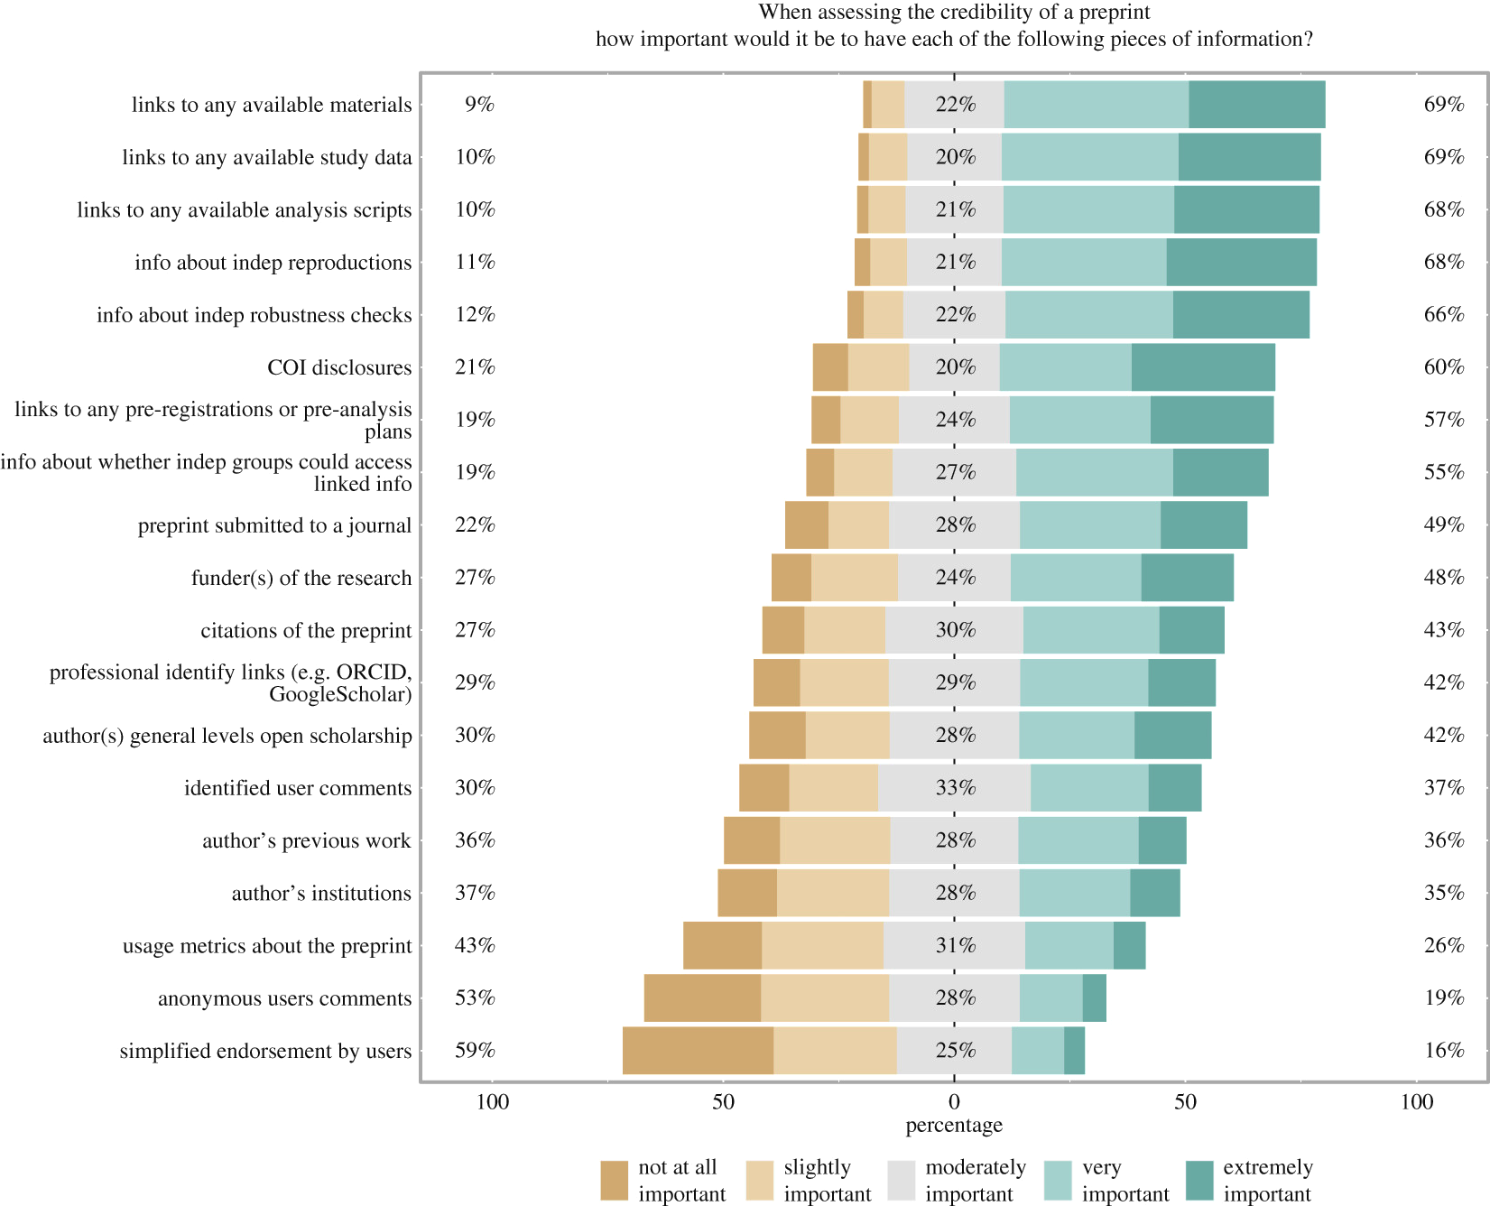
Credibility of preprints Vs Shared Information
Credibility of preprints: an interdisciplinary survey of researchers, Volume: 7, Issue: 10, DOI: (10.1098/rsos.201520)

Slide 32
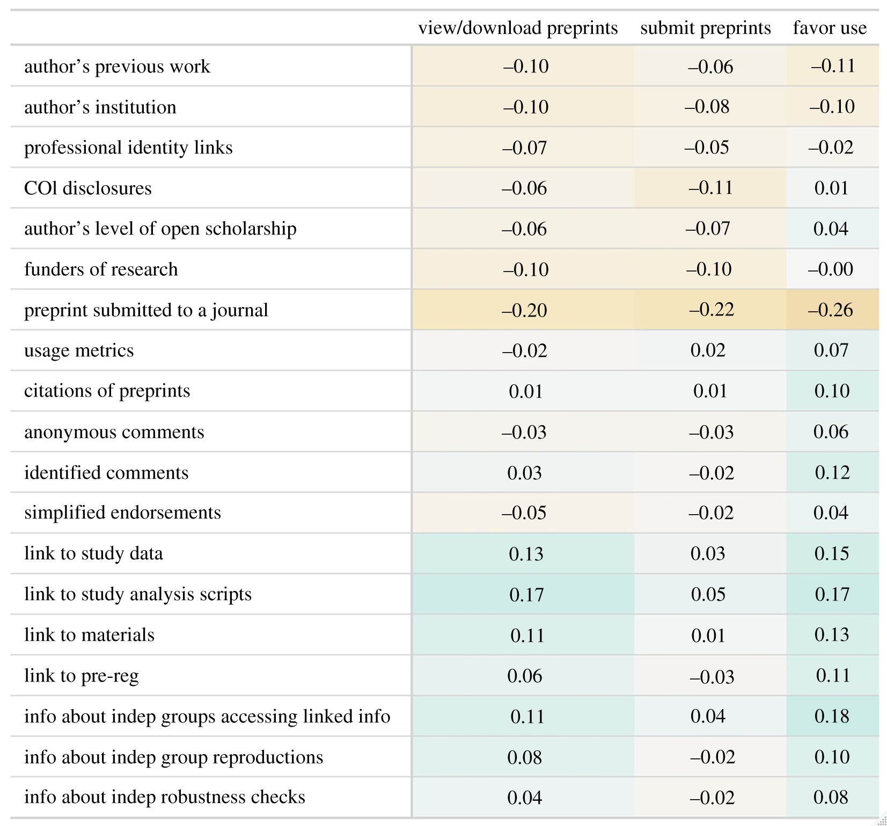
Submit preprints and view/download
Spearman correlations for the view/download and submit correlations
Pearson correlation for favourability
Credibility of preprints: an interdisciplinary survey of researchers, Volume: 7, Issue: 10, DOI: (10.1098/rsos.201520)

Slide 33
Section 4
What are the steps in submitting a preprint?

Slide 34
So you decided to preprint - now what?
Prepare your preprint.
Get all co-authors on board with preprinting. Refer to the resources in the Preprint Info Center (including these FAQ).
Double check journal policies on when and where preprints may be posted.
Choose a preprint server. Consider visibility, funder recommendations, and features like preservation and indexing, which are cataloged in the Preprint Server Directory.
Choose a license.
Upload any code/data/reagents you want to share to appropriate repositories.
Post the preprint!
Invite feedback via social media or email
https://asapbio.org/preprint-info/preprint-faq#qaef-4524

Slide 35
Prepare your Preprint
1

Slide 36
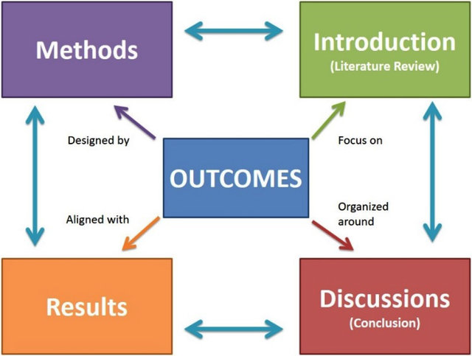
Prepare you preprint
Complete the Scientific work
Prepare a complete manuscript
Review the manuscript to avoid scientific and grammatical errors
Yusoff MSB. ABC of manuscript writing. Education in Medicine Journal. 2018;10(2):61–67. https://doi.org/10.21315/eimj2018.10.2.8

Slide 37
Seek Approval from Coauthors
2
Find preprints by your colleagues in the field or at your institution
Discuss preprints in other settings: in a journal club, etc

Slide 38
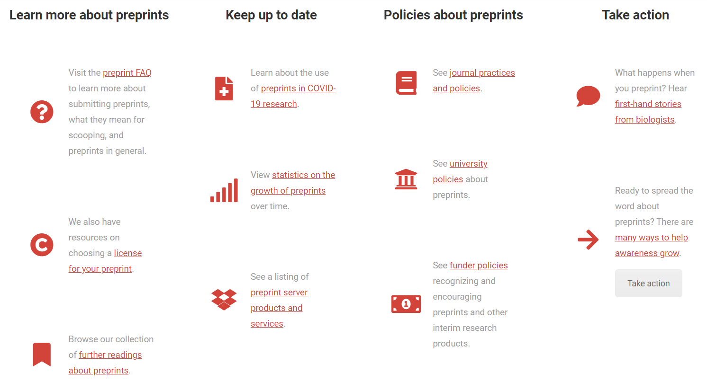
Resources for preprints
asapbio.org/preprint-info

Slide 39
Double check journal policies
3

Slide 40
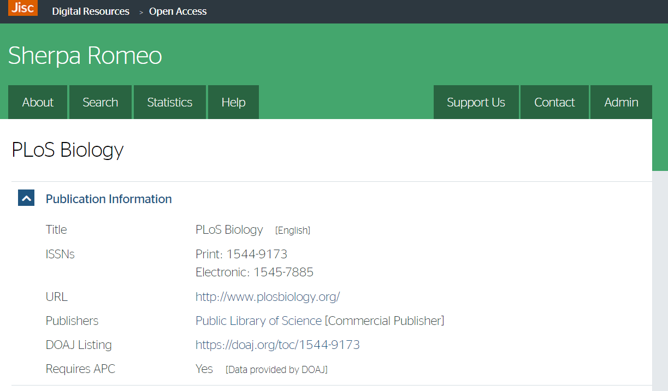
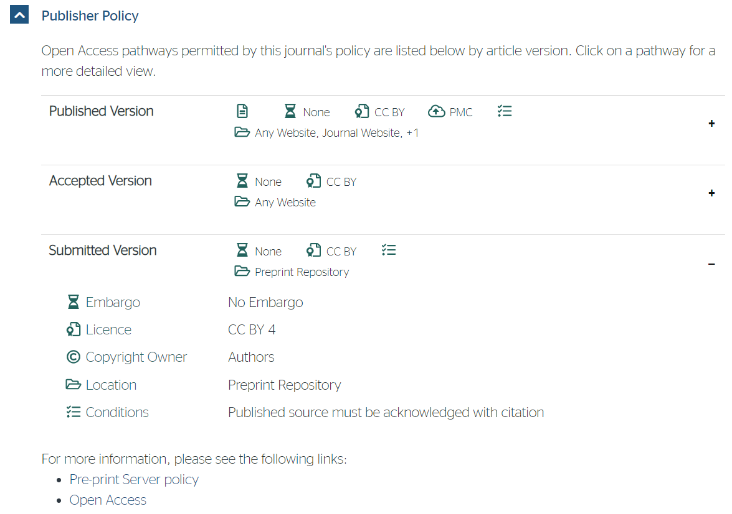
SHERPA/RoMEO is a fantastic start
sherpa.ac.uk/romeo/search.php

Slide 41
...but journal policies are much more nuanced
eg, what types of servers are allowed?
The Royal Society of Chemistry journals allow deposition with “non-commercial repositories” such as ArXiv and ChemRxiv - http://www.rsc.org/journals-books-databases/journal-authors-reviewers/processes-
Development “supports authors who wish to post primary research manuscripts on community preprint servers such as bioRxiv.” - http://dev.biologists.org/content/journal-policies#preprint
Biophysical Journal “will consider for publication manuscripts that have been posted informally on a private website or on arXiv or bioRxiv, but will not consider manuscripts that have been posted on other preprint servers or "virtual journal" websites.” - https://www.cell.com/pb-assets/journals/society/biophysj/PDFs/author-guidelines.pdf?code=cell-site

Slide 42
Choose your server
4

Slide 43




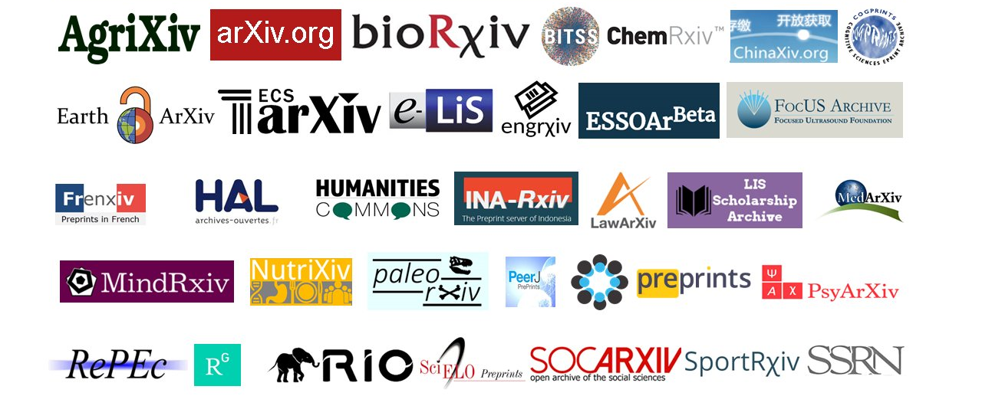
Preprints for all disciplines, languages, & communities
Image compiled by Jeroen Bosman (@jeroenbosman) via Bianca Kramer (@MsPhelps)

Slide 44
Landscape of platforms
Access to money, staff, time, publishing know-how
Philosophy on amount of gatekeeping versus speed & transparency
Motivations: from publisher-driven preprints to publishing-disruptive preprints
Multi-disciplinary platforms owned by or affiliated with for-profit publishers
Run by individual(s)
MarXiv
ViXra
Some OSF communities
Elsevier
for-profit
SSRN & First Look platforms:
Cell Press Sneak Peek, NeuroImage: Clinical First Look, Preprints with The Lancet, Surgery Open Science First Look
Authorea
Academic groups, societies or funding organisations
OSF communities:
AfricArXiv
AgriXiv
Arabixiv
EcoEvoRxiv
FocUS Archive
Frenxiv
INA-Rxiv
MetaArXiv
MindRxiv
NutriXiv
PaleoRxiv
PsyArxiv
SocArXiv
SportRxiv
Thesis Commons
Wiley/Atypon
F1000 Research
non-profit
Research Square
bioRxiv & medRxiv
Springer Nature:
BMC & Nature Research
Taylor & Francis
ESSOAr
(PeerJ Preprints)
OSF Preprints
JMIR Preprints
ChemRxiv
preprints.org
arXiv
MDPI
Open Research platforms: AAS, AMRC, Gates, HRB, MNI, Wellcome
ChinaXiv
MitoFit Preprint Archives
Therapoid
SciELO Preprints
Subject-specific platforms run by for-profit (med-tech & other) companies
multi-disciplinary
sub-disciplinary
Slide by Naomi Penfold - https://zenodo.org/record/3626770#.XraqE2hKh3h
Notes:
What’s the lowest threshold that is useful and reasonable for these various parties?
Profit/not
Publisher/academic
Generic/specific
Size/age
Preprints.org
JMIR Preprints

Slide 45
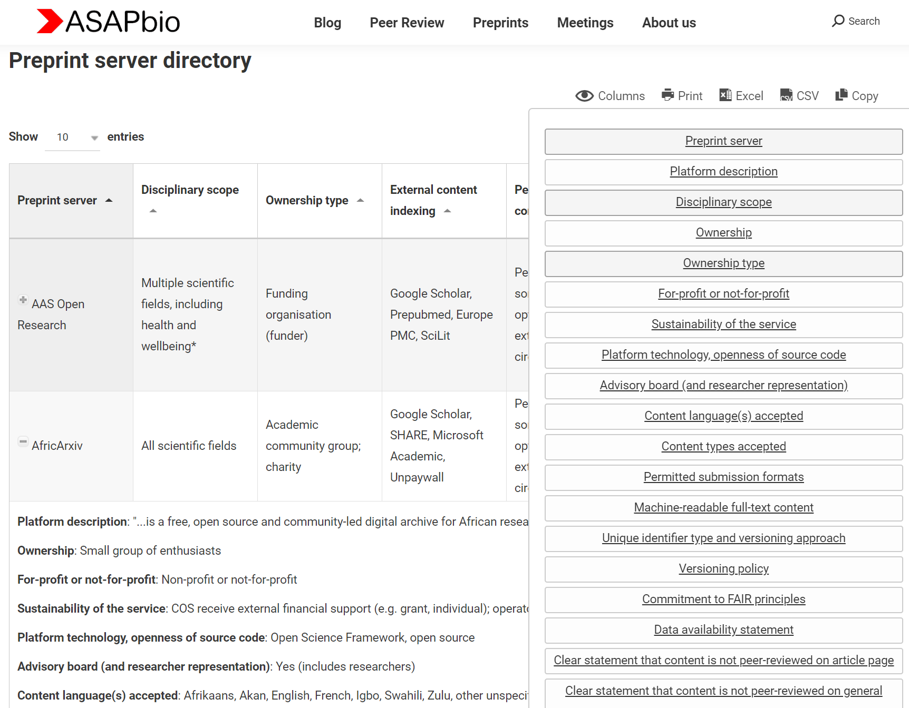
Preprint servers differ in screening, withdrawal, commenting policies
A systematic examination of preprint platforms for use in the medical and biomedical sciences setting. Jamie J Kirkham, Naomi Penfold, Fiona Murphy, Isabelle Boutron, John PA Ioannidis, Jessica K Polka, David Moher. bioRxiv 2020.04.27.063578; doi: https://doi.org/10.1101/2020.04.27.063578
https://asapbio.org/preprint-servers

Slide 46
Choose your license
5

Slide 47
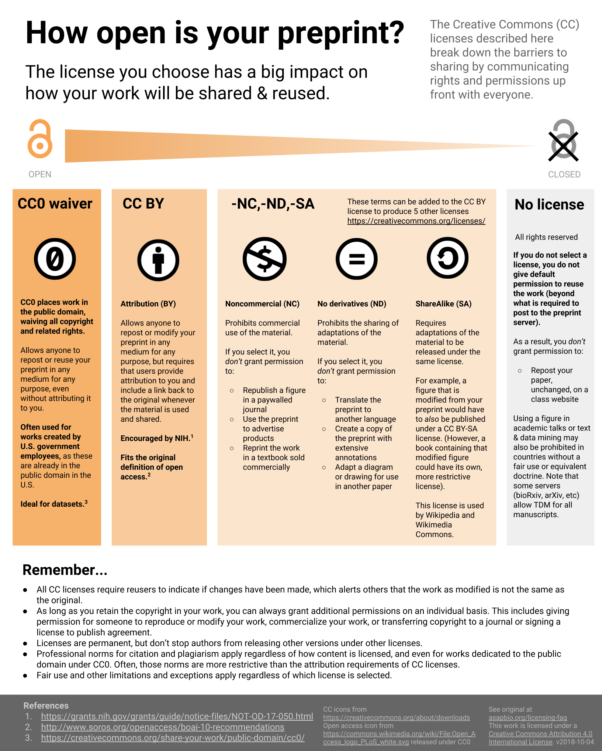
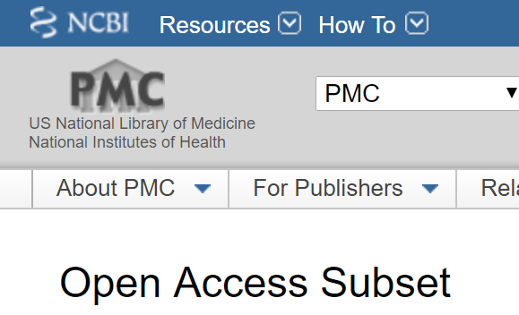
The majority of “free” literature is not open
http://asapbio.org/licensing-faq
2,080,010
out of
5,384,701
* any CC license as of 2019-02-14

Slide 48
http://asapbio.org/licensing-faq

Slide 49
http://asapbio.org/licensing-faq

Slide 50
Upload code, data, or deposit reagents
5

Slide 51
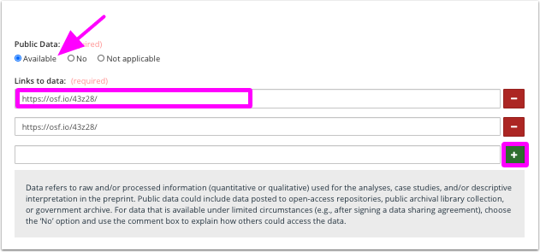
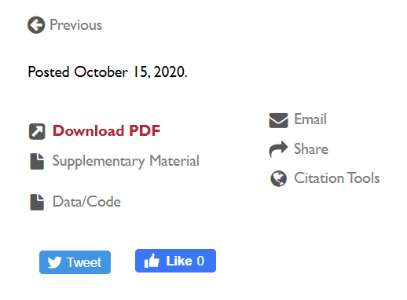
Preprints servers offering clear links to data/code
OSF
bioRxiv
A Catalogue of Databases for data: FAIRsharing.org
Recommendations for preprint data/materials statements:
Beck, Jeffrey, et al. “Building Trust in Preprints: Recommendations for Servers and Other Stakeholders.” OSF Preprints, 21 July 2020. Web. https://osf.io/8dn4w/

Slide 52
Post it!
6

Slide 53
Request feedback
7

Slide 54
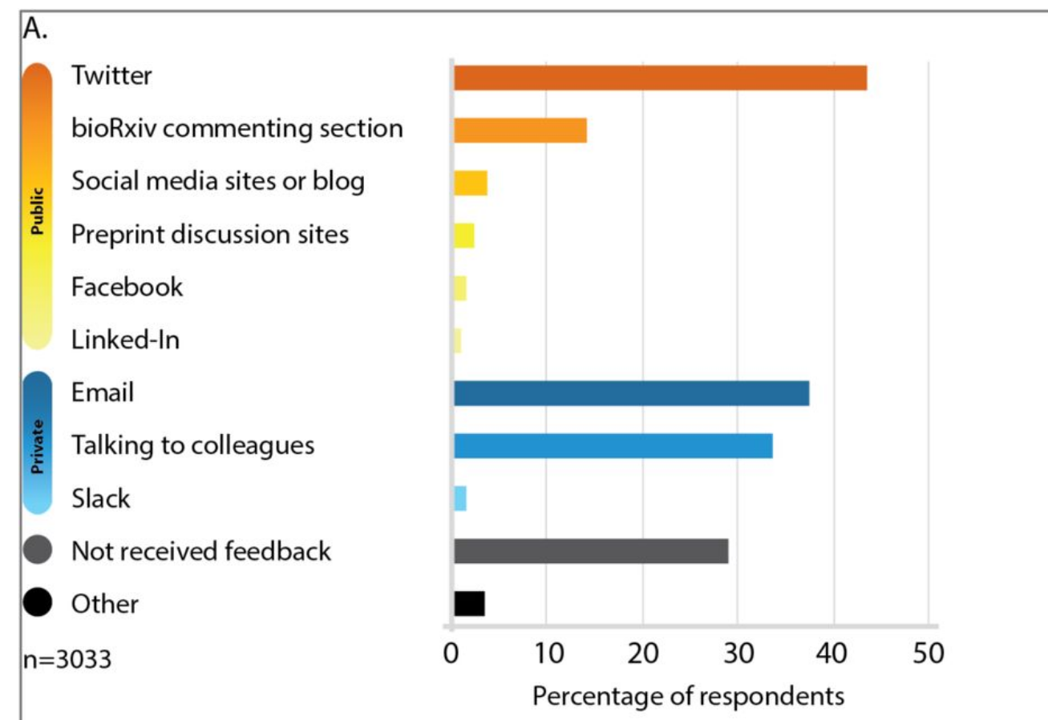
Feedback is not just in the comment section
In a survey of bioRxiv users, scientists were asked the mechanisms by which they have received feedback on papers posted on bioRxiv.
https://www.biorxiv.org/content/10.1101/833400v1.full
@jessicapolka, @ASAPbio_, #ASAPbio

Slide 55
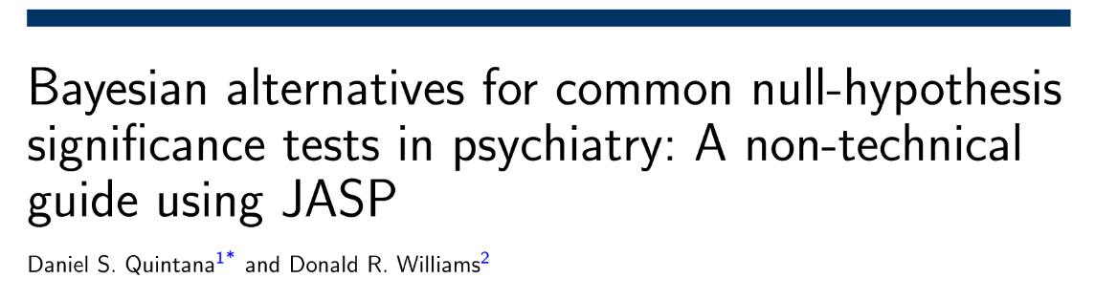
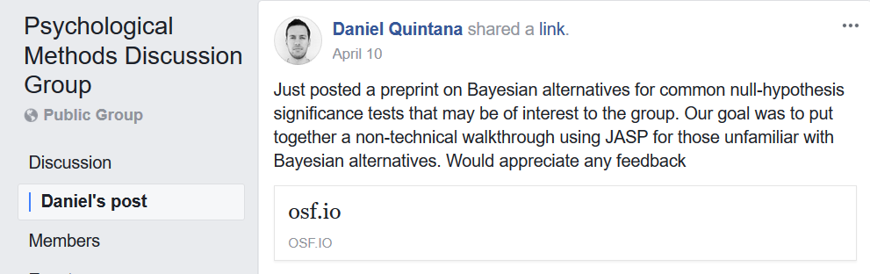
Feedback can be found all around the web
https://osf.io/sgpe9/
https://www.facebook.com/groups/853552931365745/permalink/1349684805085886/

Slide 56
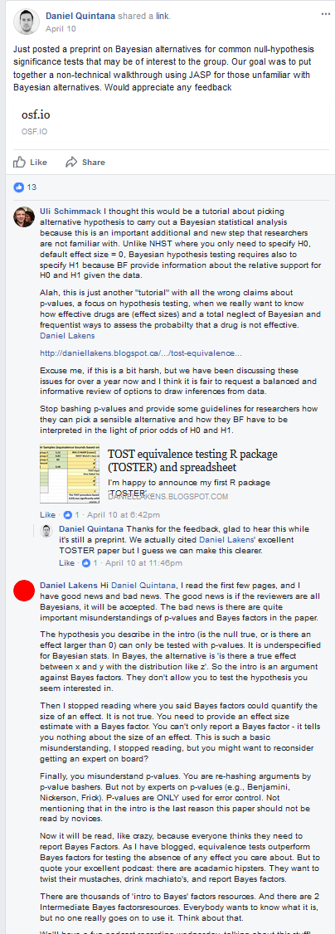
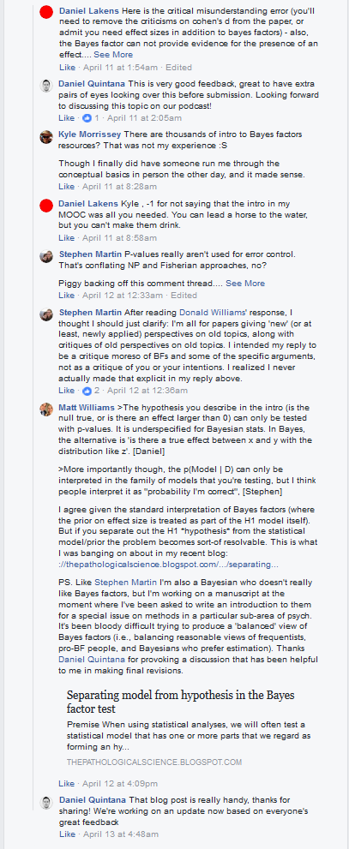
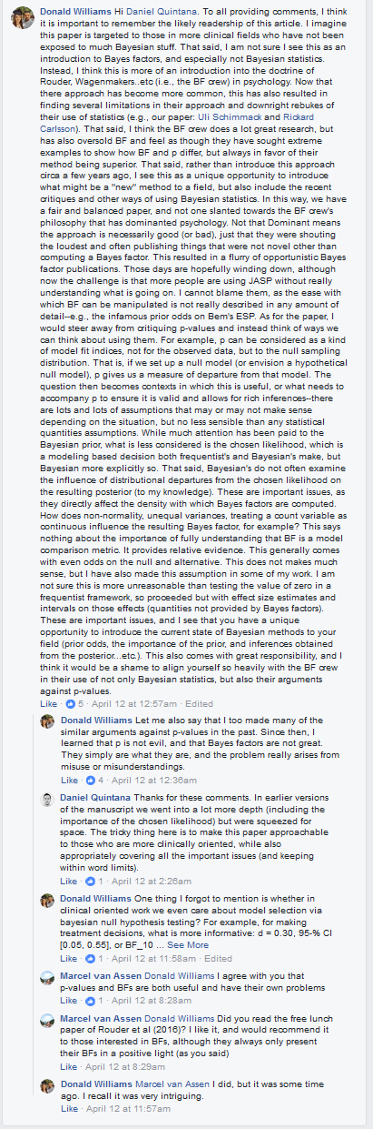
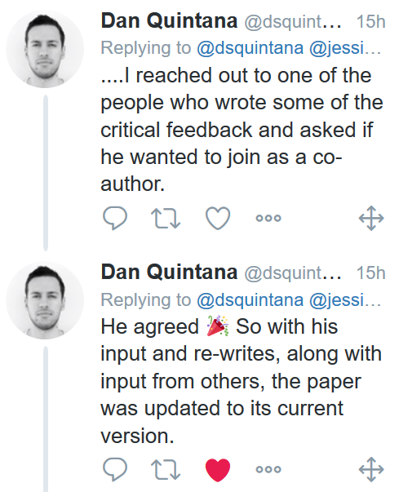
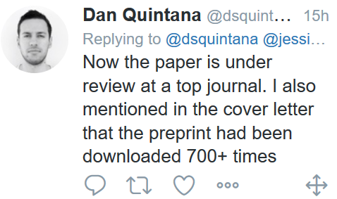

Slide 57
Revise your Preprint
8

Slide 58
Website Resources
Reasons to Worry Less About the Explosion of Preprints - Absolutely Maybe
On the value of preprints: An early career researcher perspective.
What are Preprints, and How Do They Benefit Authors? | AJE
Preprints (PLoS)

